Slide 1
Maintaining Consistency Across Data Centers or: How I Learned to Stop Worrying About WAN Latency
Randy Fradin
BlackRock

Slide 2

About the Speaker
Part of BlackRock’s Aladdin Product Group
Core Software Infrastructure - building scalable storage, compute, and messaging systems
Joined BlackRock in 2009
Using Cassandra since 2011
Excited to be speaking at #CassandraSummit 2016
Also check out my talk from Cassandra Summit 2015, “Multi-Tenancy in Cassandra at BlackRock”

Slide 3



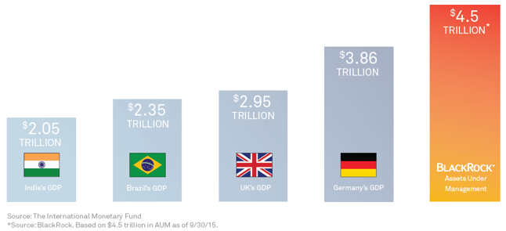
Who We Are
is the world’s largest investment manager
Over $4.5 trillion in assets under management
is the world’s largest provider of exchange-traded funds
#26 on list of the World’s Most Admired Companies 2016
Advisor and technology provider

Slide 4

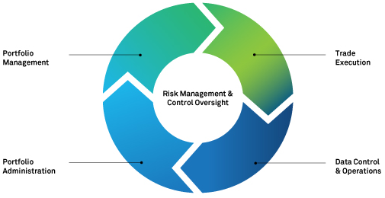
BlackRock as a Technology Provider
is BlackRock’s enterprise investment system
Used by BlackRock and more than 160 other institutions around the world
Generated over $500 million in revenue last year

Slide 5
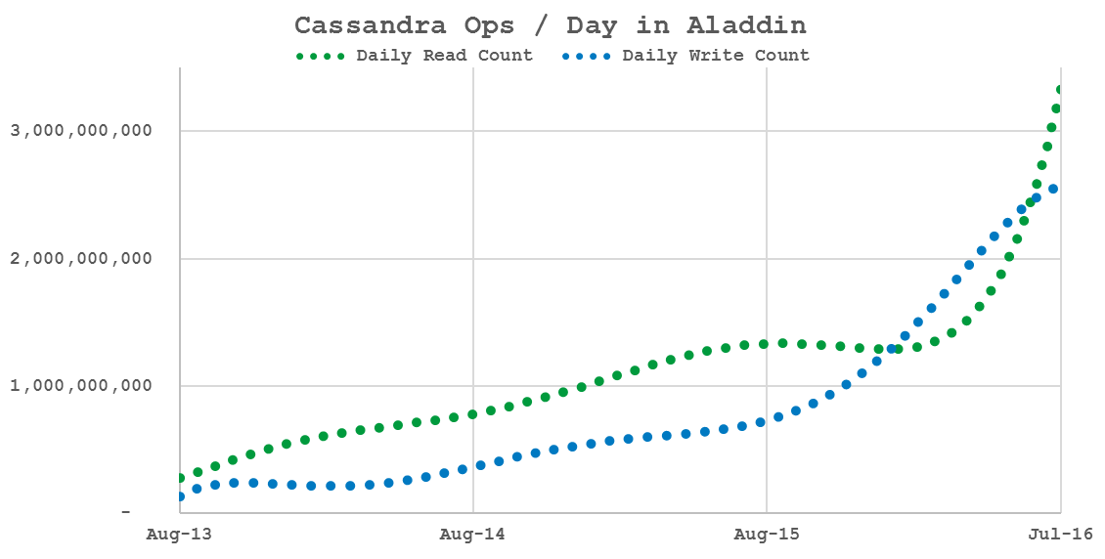
Cassandra at BlackRock
Started using Cassandra 0.6 in development in 2010
First production usage in 2011 on version 0.8
Currently on version 2.1

Slide 6
Using Cassandra in Multiple Data Centers

Slide 7
Support for Data Centers in Cassandra
A cluster can span wide distances
Disaster recovery
Proximity to other systems
In Cassandra, “data center” == replication group
Usually you group by proximity
Can also group by type of workload
SITE 1
production
workload
SITE 2
production
workload
SITE 1
analytic
workload
SITE 2
analytic
workload

Slide 8
Using Data Centers in Cassandra
Tell the cluster where your nodes are:
Use a snitch!
Tell the cluster where you want your data to go:
CREATE KEYSPACE example WITH REPLICATION =
{ ‘class’ : ‘NetworkTopologyStrategy’, ‘DC1’ : ‘3’, ‘DC2’ : ‘3’ }
Write your data and watch it replicate to all your data centers!
(…if they’re all available)
Otherwise, hinted handoff, read repair, and anti-entropy repair have your back.
= replica node
= non-replica node
Client
* not discussed: racks, tokens, vnodes

Slide 9
Cross-Data Center Optimizations
Data moving between data centers is optimized:
Cross-data center forwarding
inter_dc_tcp_nodelay
inter_dc_stream_throughput_outbound_megabits_per_sec
= data
= data + forwarding addresses
Client

Slide 10
Data Centers & Consistency Levels
Every write or read is forwarded to corresponding replicas
“consistency” = # of replies needed to succeed
Reads reflect the latest writes (“strong consistency”) when:
read consistency + write consistency > replica count
Some consistency levels are “aware” of data centers, others not:
Data center “oblivious”
ANY
ONE
TWO
THREE
QUORUM
ALL
Data center “aware”
LOCAL_ONE
LOCAL_QUORUM
EACH_QUORUM

Slide 11
Strong Consistency Across Data Centers

Slide 12
Why Strong Consistency Across Data Centers?
Typical Cassandra use cases prioritize low latency and high throughput.
But, sometimes high availability and strong consistency are more important!
Requirements:
Non-stop availability
Never lose data

Slide 13


Implementing Consistency Across Data Centers
What replication factor and consistency level should we use?
Requirements | 3 replicas per data center + LOCAL_QUORUM operations? | 1 replica per data center + QUORUM operations?
Non-stop availability
Never lose data
Locally Consistent
Globally Consistent
Client
vs
Client
Client
Client

Slide 14
Challenge 1: Latency
With all that latency on each operation, isn’t performance terrible?
Actually, this wasn’t such a problem:
10ms+ latency per operation is acceptable for many apps
Minimize use of sequential operations
High throughput still achievable
Client
QUORUM
read or write
10ms+ synchronous latency

Slide 15


Challenge 2: Inconsistent Performance
Actually, the picture is not so simple…
~12ms reads + writes from the east coast
~74ms reads + writes from the west coast
6X performance difference after failover
Client
QUORUM
takes 74ms+
74ms
Client
83ms
QUORUM
takes 12ms+
12ms
Client

Slide 16

Challenge 2: Inconsistent Performance
We expanded the cluster to a 4th data center, on the west coast
Now QUORUM = 3 out of 4 replicas
Now we have the same (slow) performance everywhere! yay?
Client
QUORUM
takes 74ms+
74ms
Client
15ms
83ms
QUORUM
takes 74ms+
12ms
74ms
Client

Slide 17
Challenge 2: Inconsistent Performance
But wait! For strong consistency we need R + W > N
So we got creative: read TWO + write THREE > (N=4)
Now reads take ~12-15ms and writes take ~74ms
Swap for write-heavy workloads: read THREE + write TWO
read @ TWO takes 15ms+
Client
write @ THREE takes 74ms+
74ms
15ms
83ms
12ms
read @ TWO takes 12ms+
74ms
Client
write @ THREE takes 74ms+

Slide 18
Challenge 3: Migrating Data Centers
Last year we migrated one of the east coast data centers
Temporarily increased replica count from 4 to 5
But TWO + THREE is not > 5 ! This violates strong consistency!
What we really wanted was TWO + ALL_BUT_ONE
But there is no ALL_BUT_ONE…

Slide 19
Challenge 3: Migrating Data Centers
So we made THREE == 4 !
… rather, we patched Cassandra to redefine THREE -> replica count minus one
read @ TWO takes 15ms+
Client
write @ “THREE” takes 74ms+
(where THREE means 4!)
read @ TWO takes 12ms+
Client
write @ “THREE” takes 74ms+
(where THREE means 4!)

Slide 20
Challenge 4: Performance Degradation
If a single node fails, read latency goes from ~12ms to ~74ms
Theoretical solution: 2 replicas per data center (8 in total), read THREE + write SIX
But, once again, there is no SIX!
write @ SIX
Client
read @ THREE
Client

Slide 21
Challenge 5: Isolating Different Workloads
It’s useful to isolate analytic workloads from production workloads …
… but this isn’t possible if “production” is doing quorum across all replicas.

Slide 22
Challenge 5: Isolating Different Workloads
Potential solution:
Configure production nodes as one data center
Use Cassandra’s rack feature to distribute data evenly
Use LOCAL_QUORUM on production nodes
Configure analytic nodes into separate “data centers”
Issues:
Does not permit TWO + THREE “quorum”
Can’t reuse the same cluster for other apps which want truly “local” LOCAL_QUORUM
Example: 3 physical sites, 4 Cassandra “data centers”
analytic
workload
production
workload
analytic
workload
analytic
workload

Slide 23
Making Consistency Pluggable
Many challenges could be solved if consistency were pluggable:
Quorum across a subset of data centers
“Uneven” quorums:
read 2 + write N-1
read (N+1)/2 + write (N/2)+1
and so on…
Local consistency with extra resiliency:
LOCAL_QUORUM + X remote replicas
LOCAL_QUORUM in 2 data centers
Consistency levels should be:
User-definable
Fully configurable
Simple for operators to deploy
Discussion is ongoing: CASSANDRA-8119

Slide 24
Other Tips for Success
Consider implications for fault-tolerance
Two nodes offline in different data centers can cause failures
Build a custom snitch to explicitly favor nearby data centers
Increase native_transport_max_threads
Enable inter_dc_tcp_nodelay
Check your TCP window size settings

Slide 25

http://rockthecode.io/
@rockthecodeIO

